Slide 1
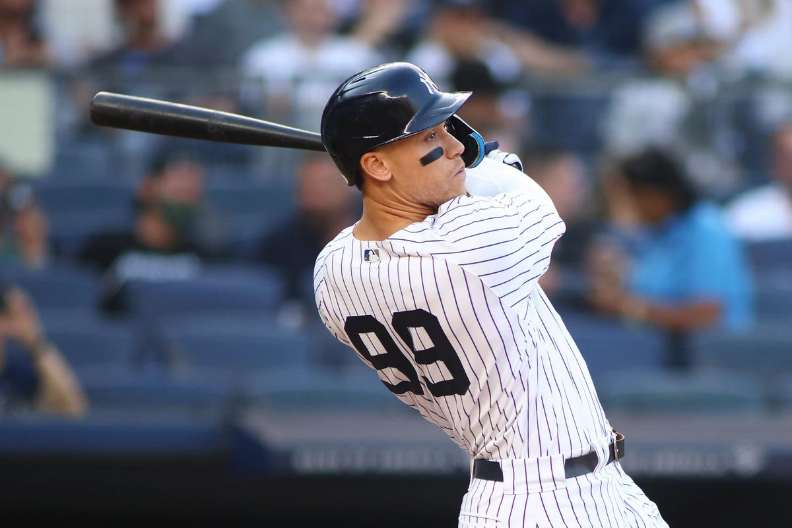

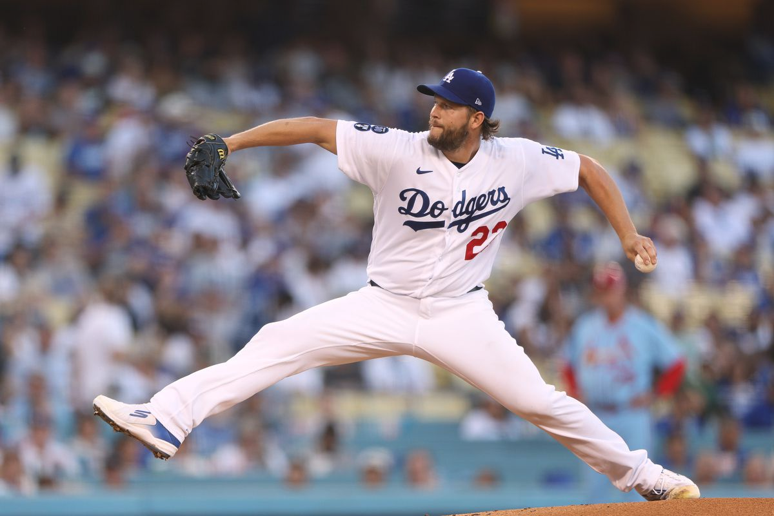
Fantasy Baseball Projections
Suhas Buravalla and Carter Rogers
DATS6501 - Data Science Capstone
.311 AVG, 62 HR, 131 RBI, 133 R, 16 SB
21 W, 1.77 ERA, 239 SO, 0.86 WHIP

Slide 2
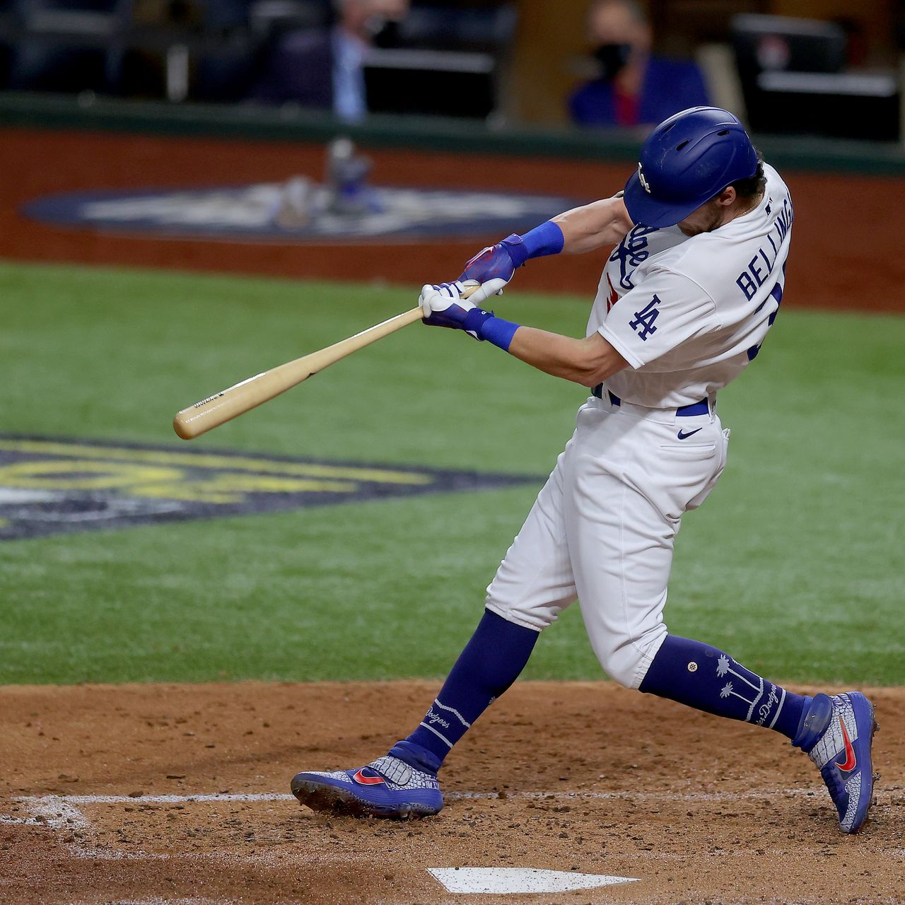
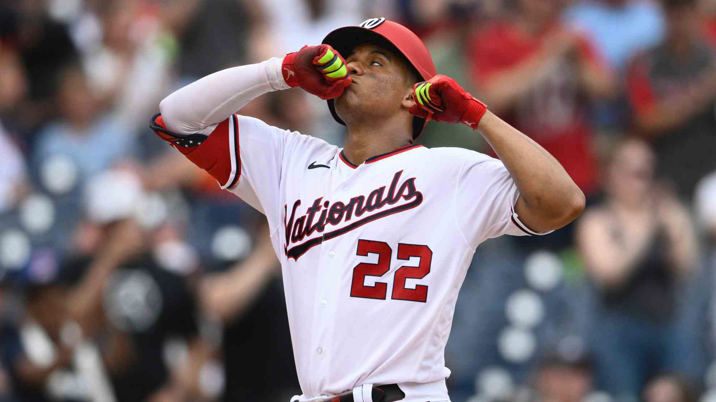

Agenda
Background
Problem Statement
Prior Research
Our Data Set: Gathering, Preprocessing, Features & Targets
Modeling: Approach & Methodology
Results
Conclusion
Fantasy Baseball Projections - DATS6501

Slide 3

Background
Major League Baseball vs. Fantasy Baseball
“Moneyball”, advanced analytics
Statcast creating new wave of data in MLB
Using data to gain competitive edge, drive decision-making
How to measure and predict player performance?
Fantasy Baseball Projections - DATS6501

Slide 4

Background
Fantasy Baseball
Rotisserie 5x5 Standard Format
Real life player results dictate success of fantasy team
Using basic stats to measure performance
How to predict player performance?
Projection systems – ZiPS, Steamer, The BAT X
Limitations
Fantasy Baseball Projections - DATS6501

Slide 5

Problem Statement
Rotisserie 5x5 Scoring:
Hitters – Batting Average, Home Runs, Runs Batted In, Runs Scored, Stolen Bases
Pitchers – Wins, Earned Run Average, Strikeouts, Saves, Walks + Hits per Inning Pitched
Problem Statement: Develop a predictive model using real-world baseball data to project future fantasy baseball results
Fantasy Baseball Projections - DATS6501

Slide 6
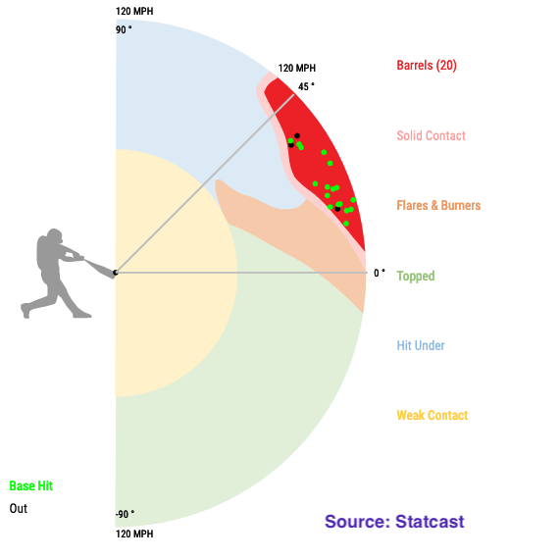
Prior Research
Eno Sarris (The Athletic) – Barrel% more predictive of future power than any other stat
Alex Fast (PitcherList) – CSW% (Called Strikes + Whiffs) stabilizes in smaller samples, highly correlated with strikeouts
Ben Clemens (Fangraphs) – Exit Velocity and Contact Rate stickiest metrics from year-to-year
Fantasy Baseball Projections - DATS6501

Slide 7


Our Data Set – Gathering
Fangraphs – historical repository for basic and advanced metrics for hitters & pitchers
2008-2022: pitch tracking era, access to metrics calculated per pitch (Swing%, CSW%)
2015-2022: Statcast metrics (Exit Velocity, Launch Angle, Sprint Speed)
Pull individual yearly statistics from 2008-2022 for hitters and pitchers
Fantasy Baseball Projections - DATS6501

Slide 8
Our Data Set – Preprocessing & Features
For each player: merge prior year’s data with following year
Impute missing Statcast metrics from 2008-2014 when unavailable
Features of both Hitters and Pitchers Data Sets – basic stats (prior year’s fantasy stats), advanced metrics, batted ball quality, swing decisions, Team, and Age
53 Features for Hitters Data Set, 59 for Pitchers
Fantasy Baseball Projections - DATS6501

Slide 9
Our Data Set – Targets
Hitters (2008-2022) – 14.3k Rows
Pitchers (2008-2022) – 7.4k Rows
X (Features) – 53 Columns
X (Features) – 59 Columns
Y₁ – Home Runs (HR)
Y₂ – Runs (R)
Y₁ – Wins (W)
Y₂ – Saves (SV)
Y₃ – Runs Batted In (RBI)
Y₄ – Stolen Bases (SB)
Y₃ – Earned Run Average (ERA)
Y₄ – Strikeouts (SO)
Y₅ – Batting Average (AVG)
Y₅ – Walks + Hits per Inning Pitched (WHIP)
Fantasy Baseball Projections - DATS6501

Slide 10

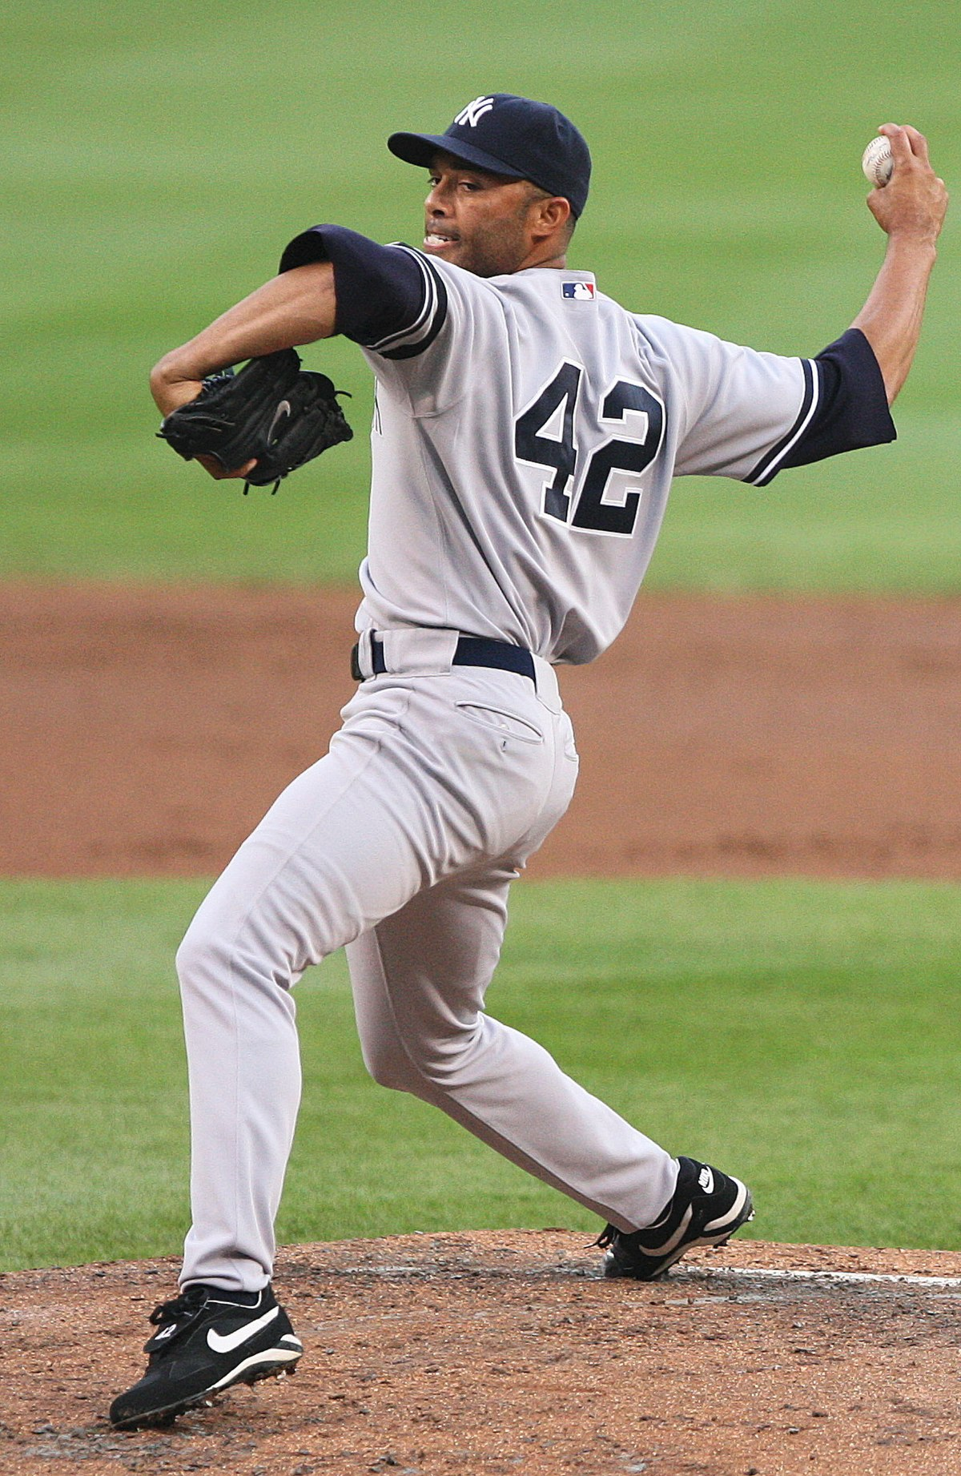
Modeling – Approach
Hardest targets to predict: SB (Hitters) and Saves (Pitchers) – why?
Wide data set – pros and cons
Prefer models with:
Support for multi-target regression output
Inherent feature selection
Better performance on data sets with fewer observations
2 models with 5 outputs each vs. 10 separate models
In general, we expect Pitchers to be harder to model
Fantasy Baseball Projections - DATS6501

Slide 11
Modeling – Methodology
Target* | Naïve Model MSE
HR | 0.516
R | 0.419
RBI | 0.434
SB | 0.521
AVG | 0.832
Naïve Model – Use prior year’s fantasy stats to predict targets
Limitations of naïve model – why can’t we use this approach?
What our modeling approach cannot account for?
Injuries – how to quantify and predict?
Trades, acquisitions, and free agent signings
Other factors – changes in pitch mix, swing alterations, offseason training, etc.
Target* | Naïve Model MSE
W | 0.841
SV | 0.717
ERA | 1.816
SO | 0.695
WHIP | 1.762
*normalized
Fantasy Baseball Projections - DATS6501

Slide 12
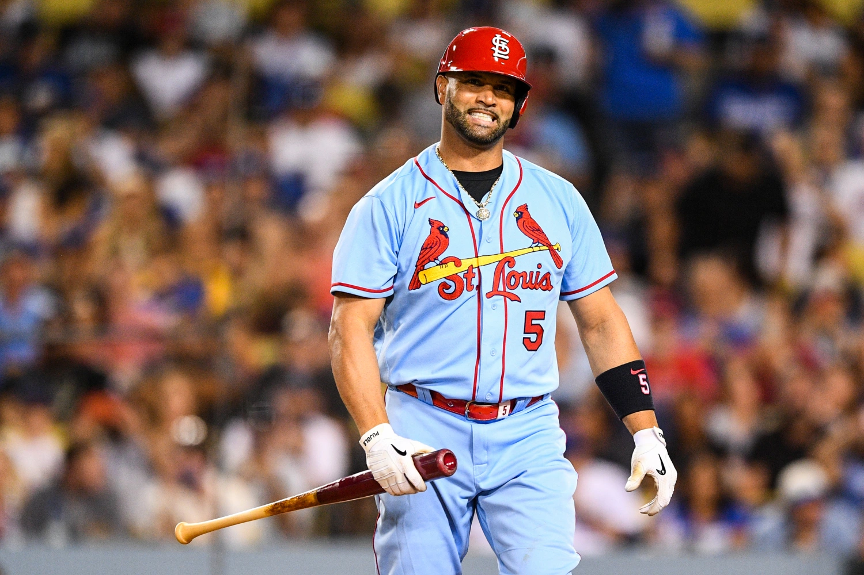

Modeling – Methodology
We want to build at least 2 models to compare performance against the baseline
Multi-target regression output options:
Linear Regression: concerns about feature selection
K-Nearest Neighbors Regression: scales poorly with increased dimensionality
Decision Tree Regression
Multi-Layer Perceptron Neural Network
Use MSE for each target to evaluate compare model performance
Fantasy Baseball Projections - DATS6501

Slide 13
Modeling – Methodology
We create two Multi-Layer Perceptron Neural Networks which can predict the 5 targets for both Pitchers and Hitters.
MLP Hitters - This network predicts the 5 targets for hitters:
HR_y, R_y, RBI_y, SB_y, AVG_y
MLP Pitchers : This network predicts the 5 targets for pitchers:
W_y, SV_y, ERA_y, SO_y, WHIP_y
Why use MLP?
Pros: Enforce multi-target output layers, inherent feature selection through training weights
Cons: Relatively small training set may limit model performance
Fantasy Baseball Projections - DATS6501

Slide 14
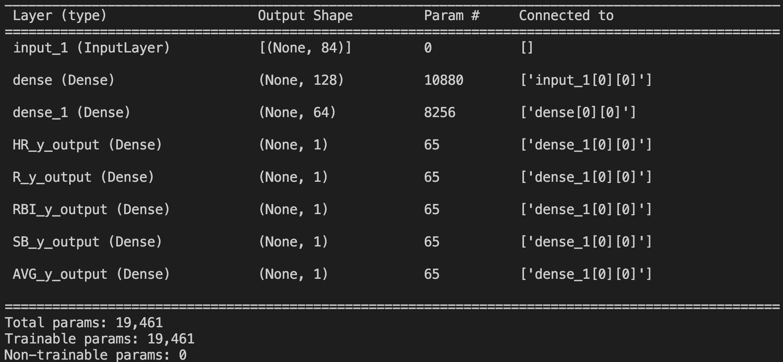
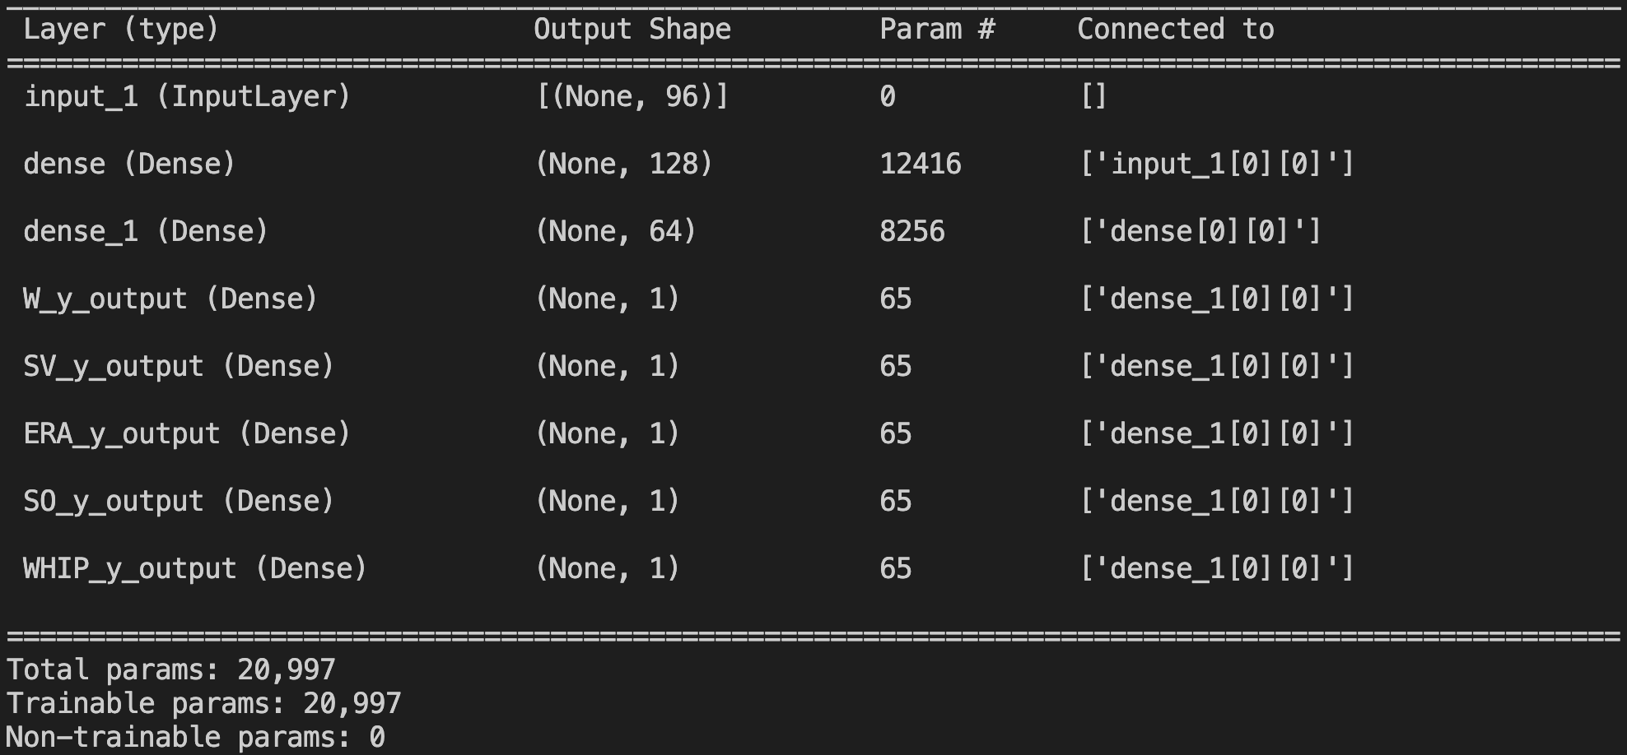
Modeling – Methodology
Network Architecture:
One input layer
Two dense layers
Separate Dense Output Layer for each of the different target variables
Training parameters:
Number of Epochs – 1000
Optimizer Used – Adam with LR = 0.00001
Fantasy Baseball Projections - DATS6501

Slide 15
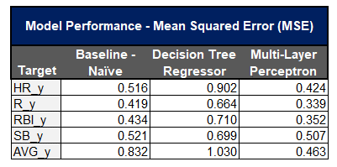
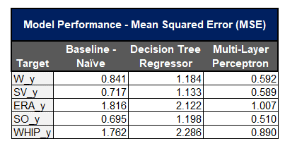
Results
Outperformed Baseline Naïve Model with MLP, but not Decision Tree Regressor (DTR)
Why? Based on Feature Importance, DTR valued counting stats over rate stats (quantity vs. quality)
Hitters MLP model drastically outperformed Pitchers MLP model
DTR Hitters Top Features: Strikeouts, RBI, Doubles
DTR Pitchers Top Features: Earned Runs, Walks/9 Innings, Slider%
Fantasy Baseball Projections - DATS6501

Slide 16

Conclusion
We outperformed baseline using MLP Neural Network Models for Hitters and Pitchers Fantasy Stats (targets)
Best performance on Runs (Hitters) and Strikeouts (Pitchers)
Worst performance on Steals (Hitters) and ERA (Pitchers)
Hitters’ performance easier to predict than Pitchers’ performance – why?
Theories: pitchers more prone to injuries, team/player development context more important, starter/reliever split
What’s next? Per-pitch data → predictive modeling
Fantasy Baseball Projections - DATS6501

Slide 17
Works Cited
Sarris, Eno. “Sarris: 10 Bold Predictions for the 2023 MLB Season.” The Athletic, 24 Mar. 2023, https://theathletic.com/4312841/2023/03/24/sarris-ten-bold-predictions-mlb-2023/.
Fast, Alex. “CSW Rate: Intro to a New Fantasy Baseball Metric.” Pitcher List, 5 Dec. 2022, https://www.pitcherlist.com/csw-rate-an-intro-to-an-important-new-metric/.
Clemens, Ben. “You Can't Fake Exit Velocity.” FanGraphs Baseball, 6 Feb. 2023, https://blogs.fangraphs.com/you-cant-fake-exit-velocity/.
Fantasy Baseball Projections - DATS6501

Slide 18
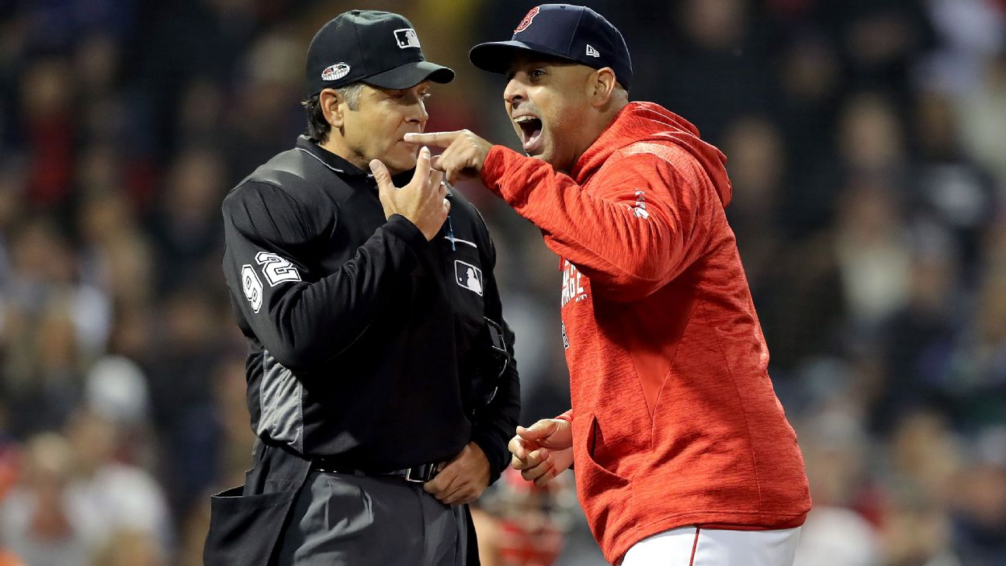
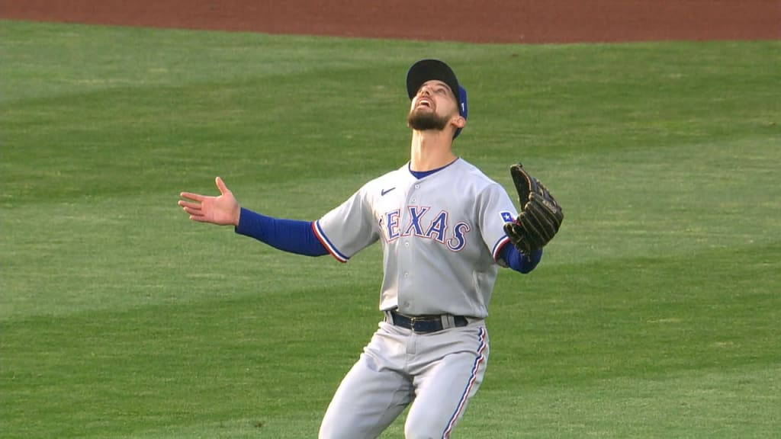
Questions?
Fantasy Baseball Projections - DATS6501

